Slide 1
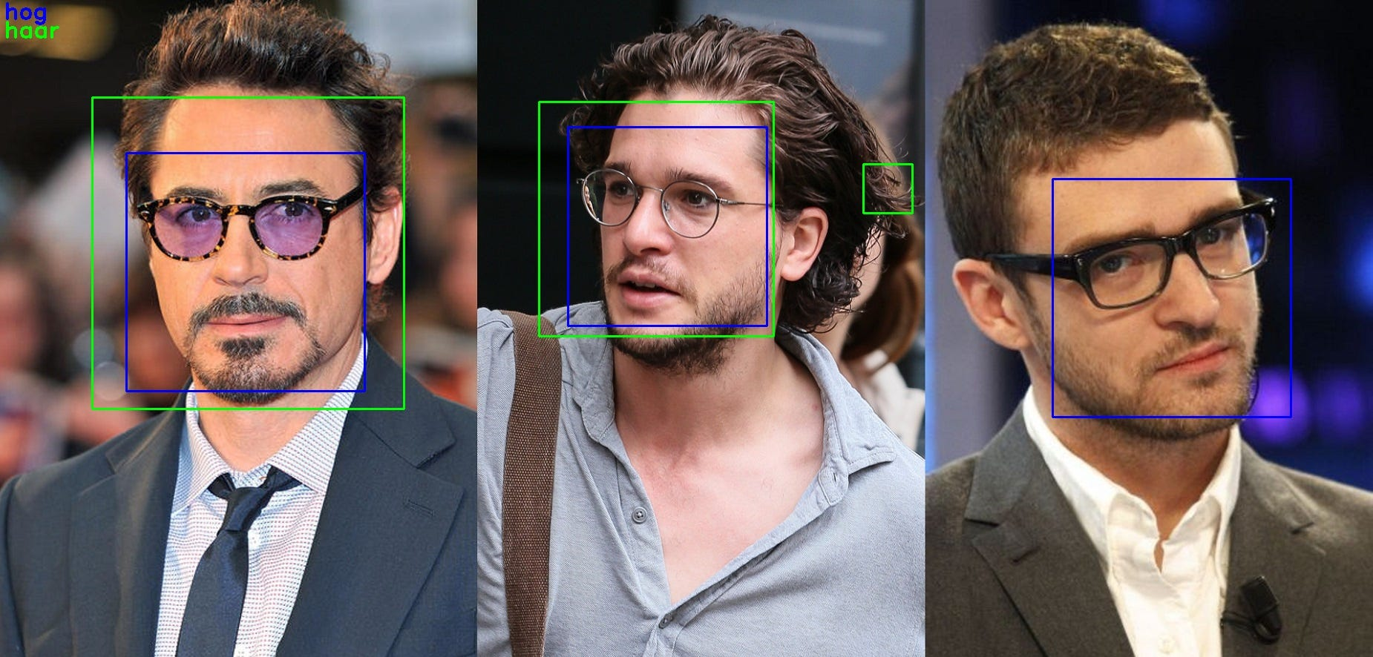
Face Glass Detection (Glasses or No Glasses)
Artificial intelligence & mAchine learning

Slide 2
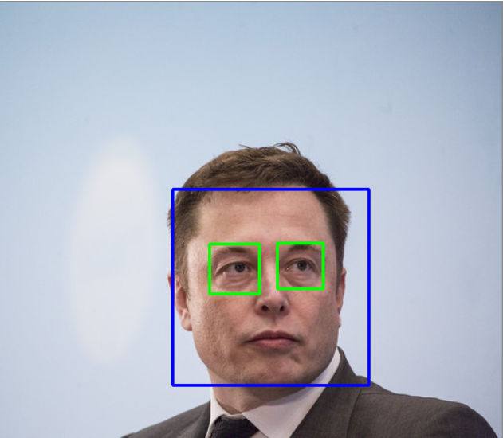

Face glass detection
Kore Ganesh (2103A52022)
Junna Radha Krishna (2103A52192)
Under The Guidance of
MR.D.RAMESH SIR
Asst.Professor
School of CS&AI
SR University

Slide 3
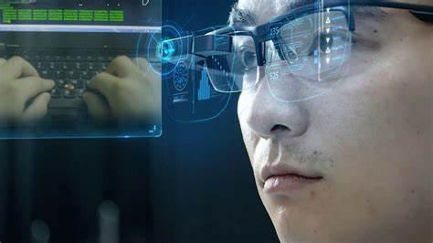
INTRODUCTION :
Face glass detection is the process of detecting glasses on a person's face in an image or video frame. The application of face glass detection can be diverse, ranging from security and surveillance to retail applications. The detection of glasses on faces can help in enhancing security measures by identifying individuals and monitoring their activities. It can also be used to monitor compliance with dress codes, particularly in professions where wearing glasses may be prohibited. Additionally, it can be utilized in retail settings to enable virtual try-on of glasses.

Slide 4
PROBLEM STATEMENT:
The problem statement of face glass detection is to develop an algorithm or system that can accurately and efficiently detect whether a person in an image or video is wearing glasses or not. This problem is important in several applications, such as surveillance, security, and face recognition.
The difficulty in this problem is that glasses can vary in shape, size, color, and transparency, and can be worn in different ways, making it challenging to accurately detect them in various scenarios. Additionally, lighting conditions, occlusions, and other factors can also affect the accuracy of detection.

Slide 5
PROPOSED STATEMENT:
The proposed work predicts whether a person is wearing glass or not by exploring the above mentioned four classification algorithms and does performance analysis. The objective of this study is to effectively predict if there is glass or not. The data is fed into model which predicts the probability of glass in the image.
CNN: CNNs are a type of deep learning algorithm that have been successfully used for face and glass detection. These networks are trained on large datasets of faces and glasses to learn the features that distinguish them from other objects in an image.
Image acquisition -> Image pre-processing -> Image segmentation -> Feature Extraction -> Glasses or no glasses classification.

Slide 6



IMAGES:
Without glasses:

Slide 7



IMAGES:
With Glasses:

Slide 8
LEARNING MODEL:
supervised
learning

Slide 9
DATASET:
https://drive.google.com/drive/folders/1xoyV73axan8I3Hi36VtnqRuEY9x8LQER?usp=share_link

Slide 10
DATA CONVERSION :
Data conversion from image data to an array is an important preprocessing step in many machine learning and computer vision applications. When working with images, we typically represent them as matrices of pixel values. However, machine learning algorithms require numerical data in form of arrays or tensors to be able to process the data effectively.
One common method of converting image data to an array is by using opencv, an open-source computer vision library. Opencv provides a range of functions to load, process and manipulate image data in a variety of formats. To convert an image to an array using opencv, we first load the image using the imread() function. This function reads the image and returns a numpy array representation of the image in bgr format. We display the image by using pyplot() module we use imshow function from it.

Slide 11
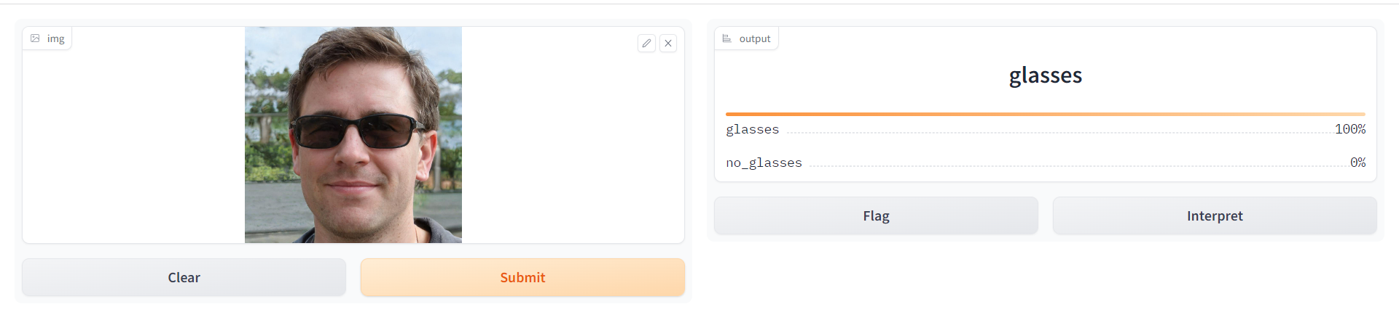
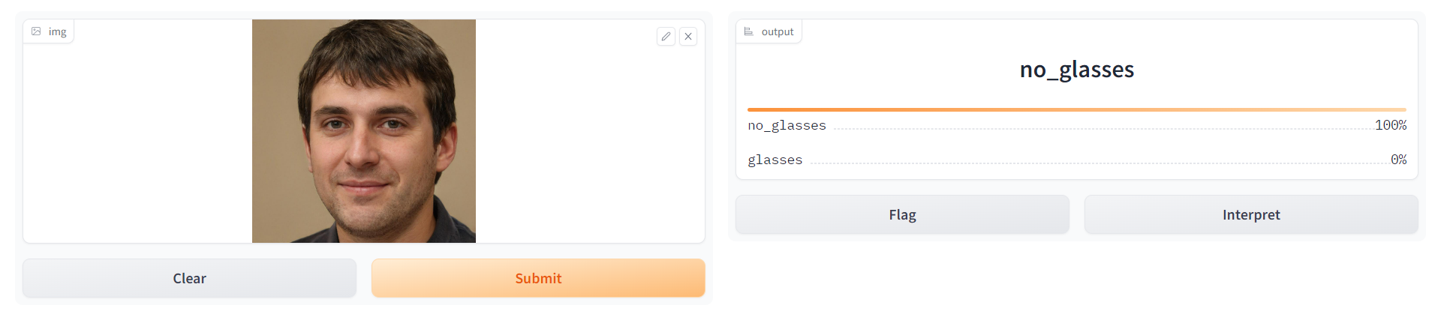
RESULT:

Slide 12
CONCLUSION:
In conclusion, face glass detection is an important task with various applications, including surveillance, security, and retail. Over the years, significant progress has been made in developing accurate and efficient face glass detection systems using various algorithms and techniques such as HOG-based object detection, CNN-based classifiers, and feature extraction and classification algorithms.
However, there is still scope for improvement in face glass detection systems. One area for future research is to develop more robust algorithms that can handle variations in glasses shape, size, color, and transparency, as well as occlusions and lighting conditions. Another area for improvement is to address privacy concerns and comply with applicable laws and regulations regarding the use of facial recognition technology.

Slide 13
THANK YOU !

